Slide 1
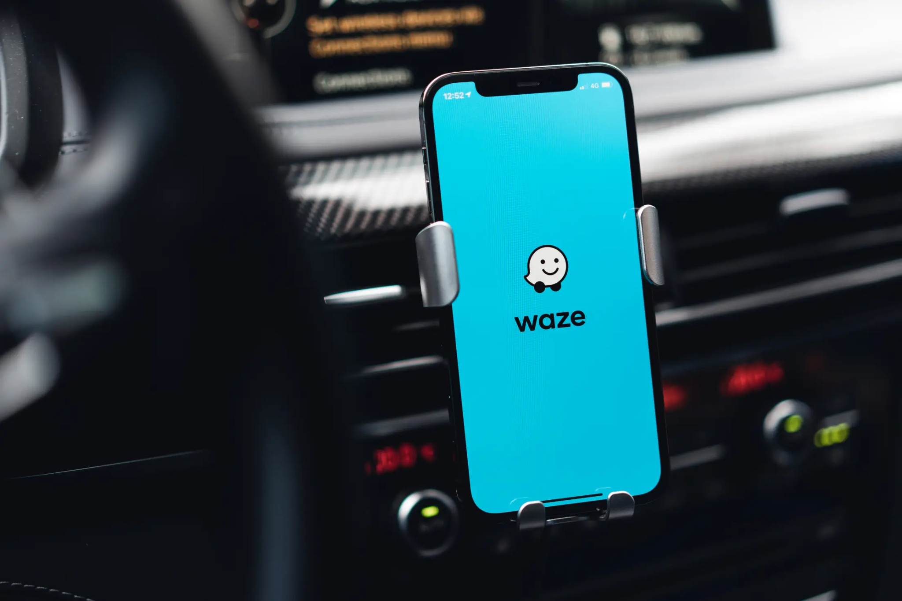
Waze Project
Group 8
Group Members:
- Kevin Obote - 190696
- Faith Nyaboke - 192745
- Grace Munyi - 054879
- Victor Radeny - 119368
- Kelvin Ngigi - 192743

Slide 2
Table of Content
Background
Problem statement
Objective
Exploratory Data Analysis Overview
Data Variables
Answer Objective Questions
Recommendations

Slide 3

Background
Waze is a community-driven navigation app that provides real-time traffic information through satellite navigation software on smartphones and turn-by-turn voice navigation to offer the fastest and most efficient routes.
It allows users to share real time updates on:
Road conditions
Traffic Jams
Accidents
Police Checks etc

Slide 4
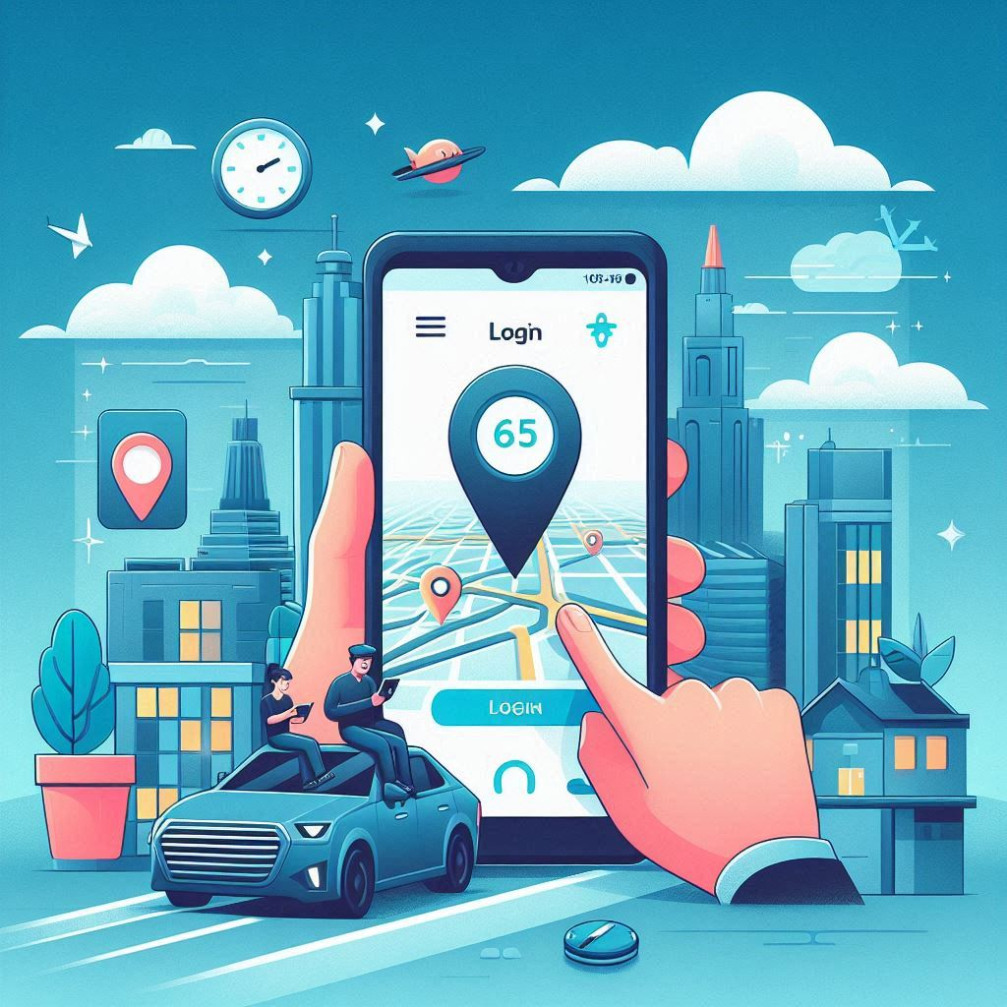
Problem Statement
Waze, a navigation app is facing the challenge of high user churn. Users are stopping their use of the app over time.
Negative impact:
Reduced user retention
Reduced overall business growth.
Our aim is to identify users at risk of churning and implement strategies to keep them engaged and satisfied, thereby improving retention rates and fostering long-term user loyalty.

Slide 5
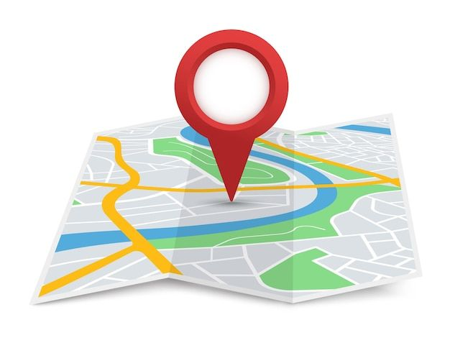
Our Objective
Analyze User Activity and Engagement Data: Examine the dataset to understand patterns and behaviors that indicate user engagement and potential churn.
Build a Predictive Model for Churn: Develop a model to identify users at risk of churning, enabling Waze to implement targeted interventions to improve user retention and satisfaction.
Provide actionable insights to improve user retention

Slide 6
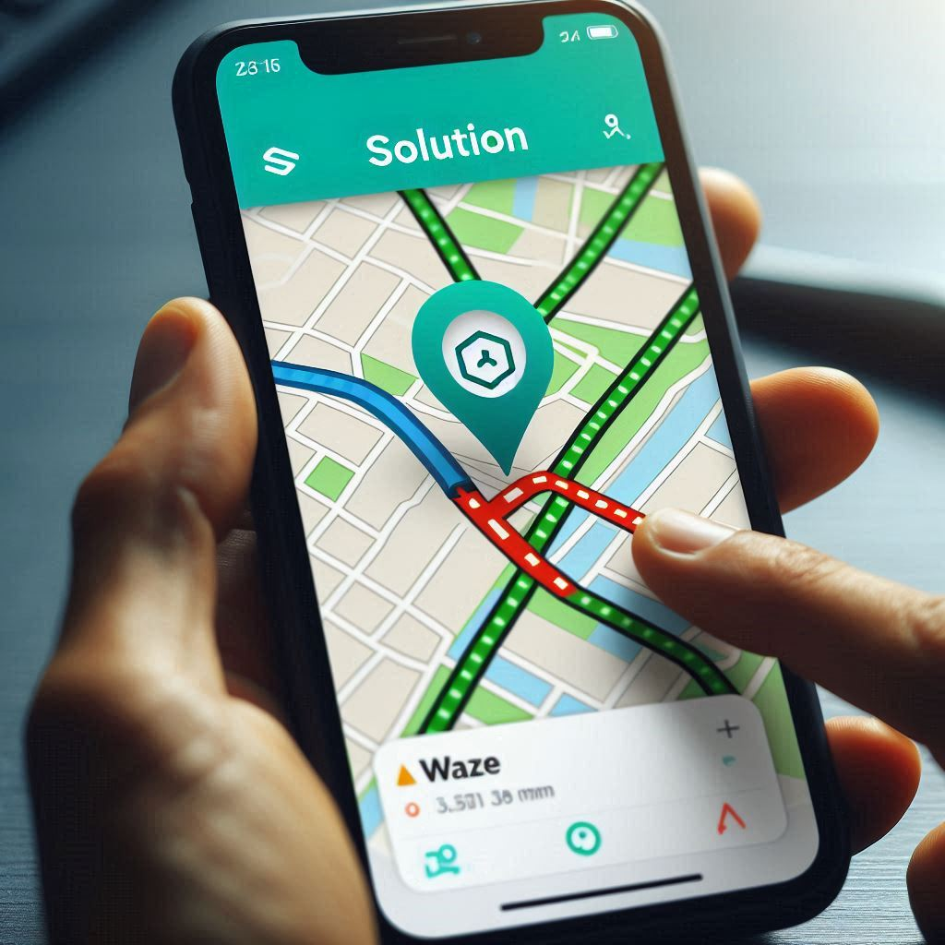
EDA Overview
Step 1) Exploratory Data Analysis
Checked for missing values in the dataset
Replaced them with mean and mode
Checked for duplicate rows
Feature engineering - combining variables to create new ones (
Visualization

Slide 7
The Data Variables
label (obj): Binary target variable (“retained” vs “churned”) for if a user has churned anytime during the course of the month
sessions (int): The number of occurrence of a user opening the app during the month
drives (int): An occurrence of driving at least 1 km during the month
device (obj) : The type of device a user starts a session with
total_sessions (float) : A model estimate of the total number of sessions since a user has onboarded
n_days_after_onboarding (int) : The number of days since a user signed up for the app
total_navigations_fav1 (int) : Total navigations since onboarding to the user’s favorite place 1
total_navigations_fav2 (int) : Total navigations since onboarding to the user’s favorite place 2
driven_km_drives (float) : Total kilometers driven during the month
duration_minutes_drives (float) : Total duration driven in minutes during the month
activity_days (int) : Number of days the user opens the app during the month
driving_days (int) : Number of days the user drives (at least 1 km) during the month

Slide 8
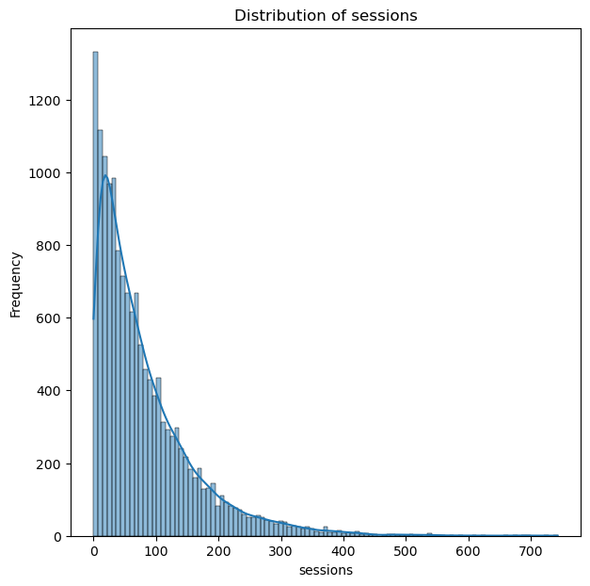
User Activity and Engagement Data Analysis
We sampled a few variables from the data set, like;
Sessions.
Distribution and frequency of the number of sessions per user
Findings
-The dataset peak is on the lowest end session range
(less than 100 sessions)
-Many users try the app - It is a highly valuable product.
-But most only engage with the app for few sessions
-Some few drivers stay on and use the app for higher number of
times.
Possible reasons
-App may have a complex User Interface
-App could be slow in loading
-Navigation could be inaccurate

Slide 9
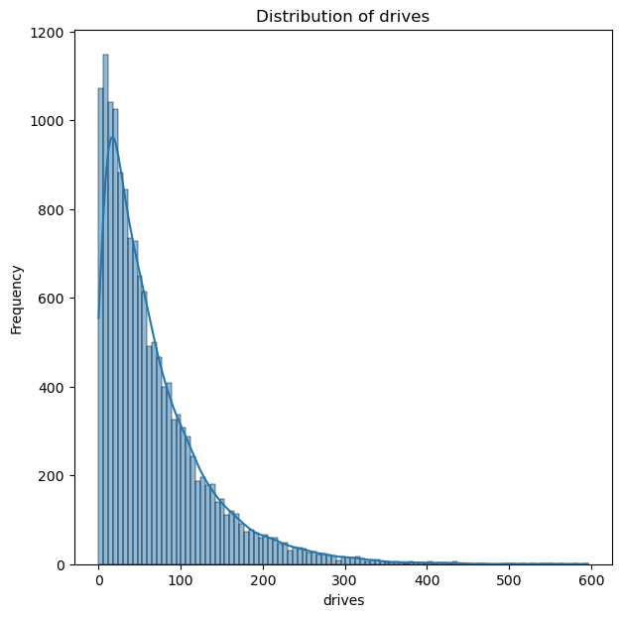
User Activity and Engagement Data Analysis
B) Drives
Distribution and frequency of the number of drives per user
Findings
-Similar to sessions histogram
User engagement is low:
Most users have relatively low number of drives.
App retention rate is low:
As number of drives increase, frequency of users decreases

Slide 10
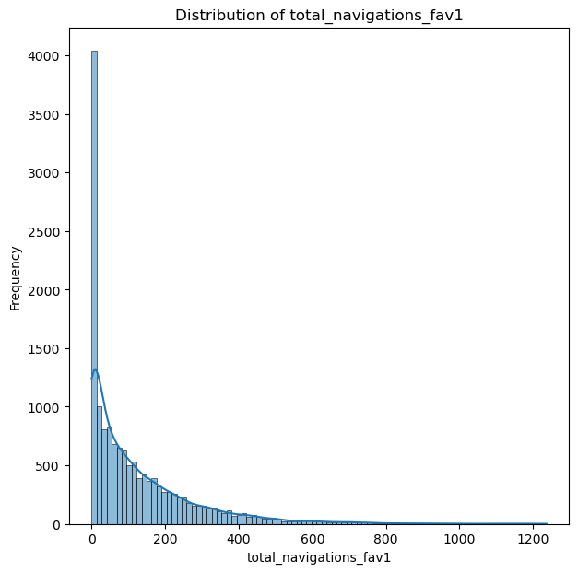
User Activity and Engagement Data Analysis
C) Distribution of Total Navigation Fav 1
Distribution of the number of navigation to the first favourite
location
Findings
-This was quite low as the highest frequency was in the zero
Navigation.
- Very few users navigate to their favorite locations.
Possible reason
-App usability is difficult hence hard for users to set navigation
-Users dont know how to effectively use this feature
–Tied to the low session and drive retention rate

Slide 11
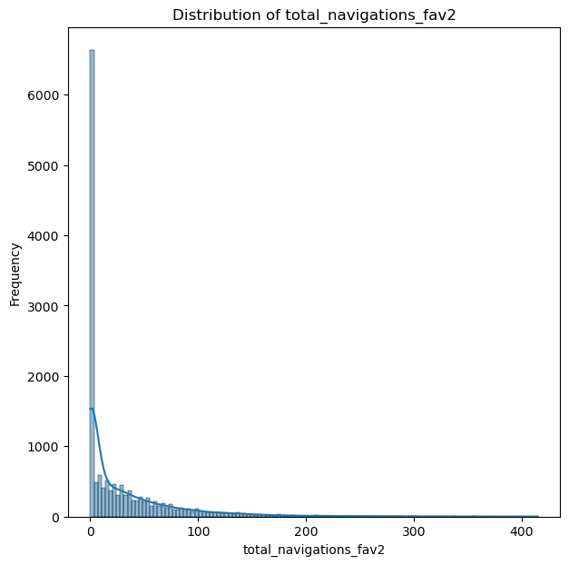
User Activity and Engagement Data Analysis
D) Distribution of Total Navigation Fav 2
Distribution of the number of navigation to the first favourite
location
Findings
-This was lower than Navigation Fav 1
More fewer users navigating to their second favorite locations
Possible reason
-App usability is difficult hence hard for users to set navigation
-Users dont know how to effectively use this feature
–Tied to the low session and drive retention rate

Slide 12
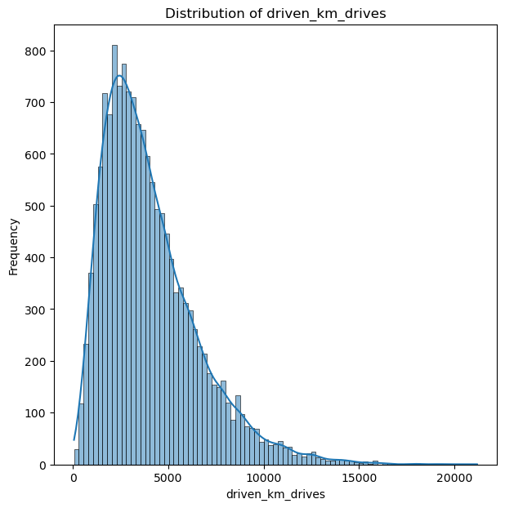
User Activity and Engagement Data Analysis
E) Distribution of driven KM
Provides insight into the distance users are driving
-Most users have driven around 4,000km which is the peak distance.
-A few have managed to extend to 10,000km and above.

Slide 13
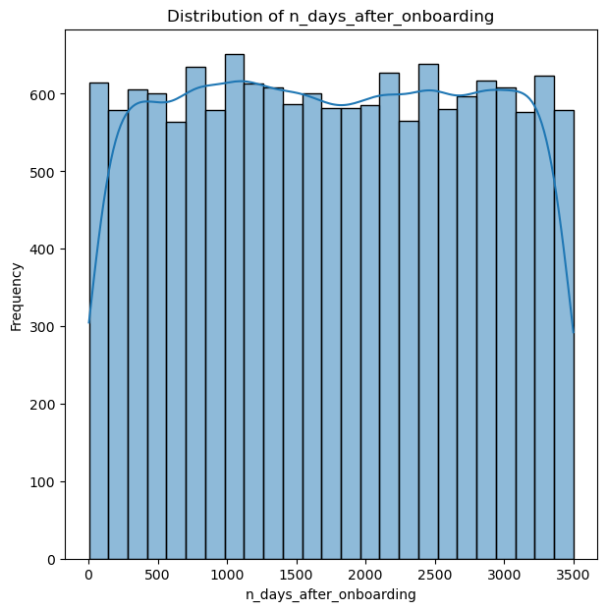
User Activity and Engagement Data Analysis
F) Distribution on n days after onboarding
Provides insight into user retention over time
Despite few usage period, the frequency of App usage after onboarding
Is high and the number of days are more (3,500)
Possible reasons
Users keep coming back to the app
Users find the app valuable & would like to use it more often

Slide 14
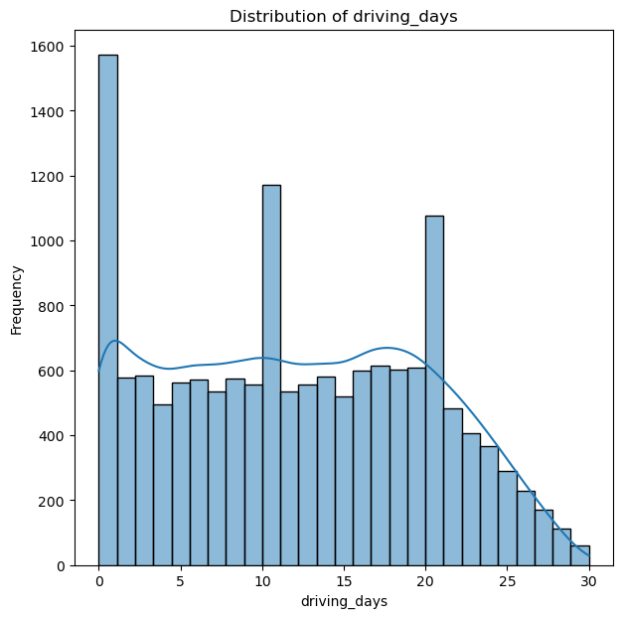
User Activity and Engagement Data Analysis
G) Distribution of Driving days
Most Waze App users are driving within the first 20 days, using the app
The app usage frequency starts declining after the 20th days
The few users that are retained are likely the ones who:
drive more kms
Log in more sessions
Log in more drives

Slide 15
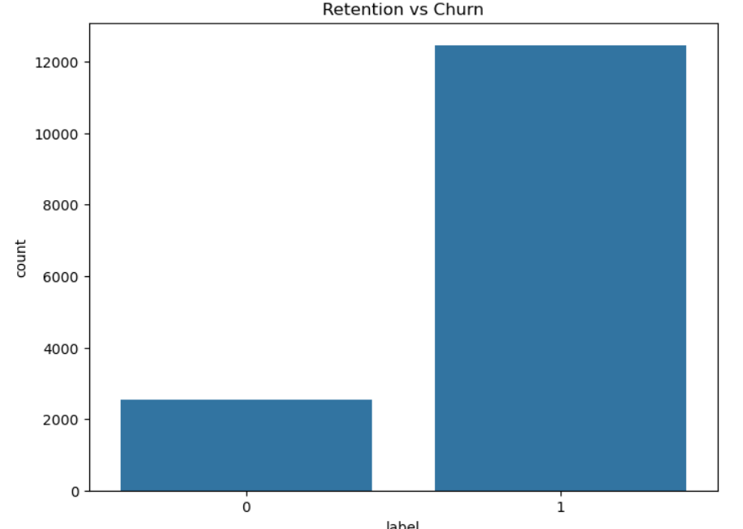
Churn Vs Retain
Overall retention rate count is higher than Churn rate.
This is despite all the above variables indicating contrary.
Possible reason
There might be discrepancies or errors like missing values in the data collected.
Type of phone being used: iPhone is supporting the app better than Android.
Different segments of the user base might have varying retention and churn rates.

Slide 16
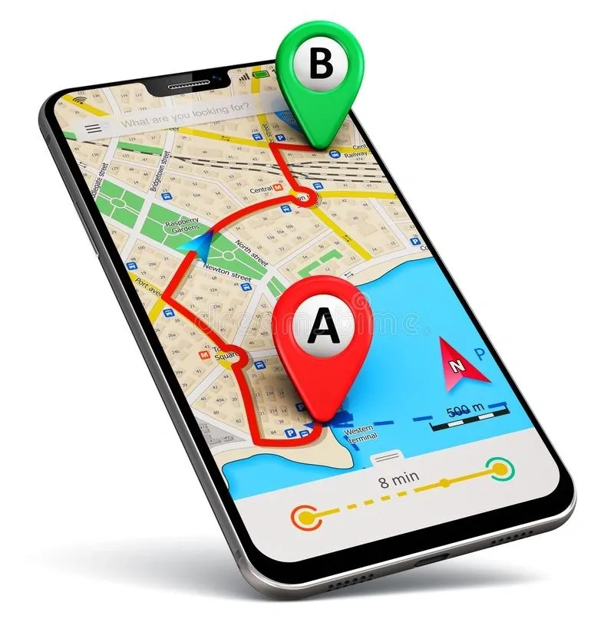
Recommendations
Strategies to improve user retention
For high churn rate users.
-Check if any of the 3 possible reasons mentioned are
causing the high churn.
-Understand the characteristics of users with low session
count.
-Study features and behaviour of highly engaged users.
What drives their high usage and apply it to low engagement users.
-Offer an active customer support/feedback feature that
users can quickly use to report app issues.

Slide 17
Strategies to improve user retention
For high usage customers
-Offer premium features, advertisement or other monetized strategies.
-Use competitive leaderboard with milestone
rewards to increase app engagement.

Slide 18
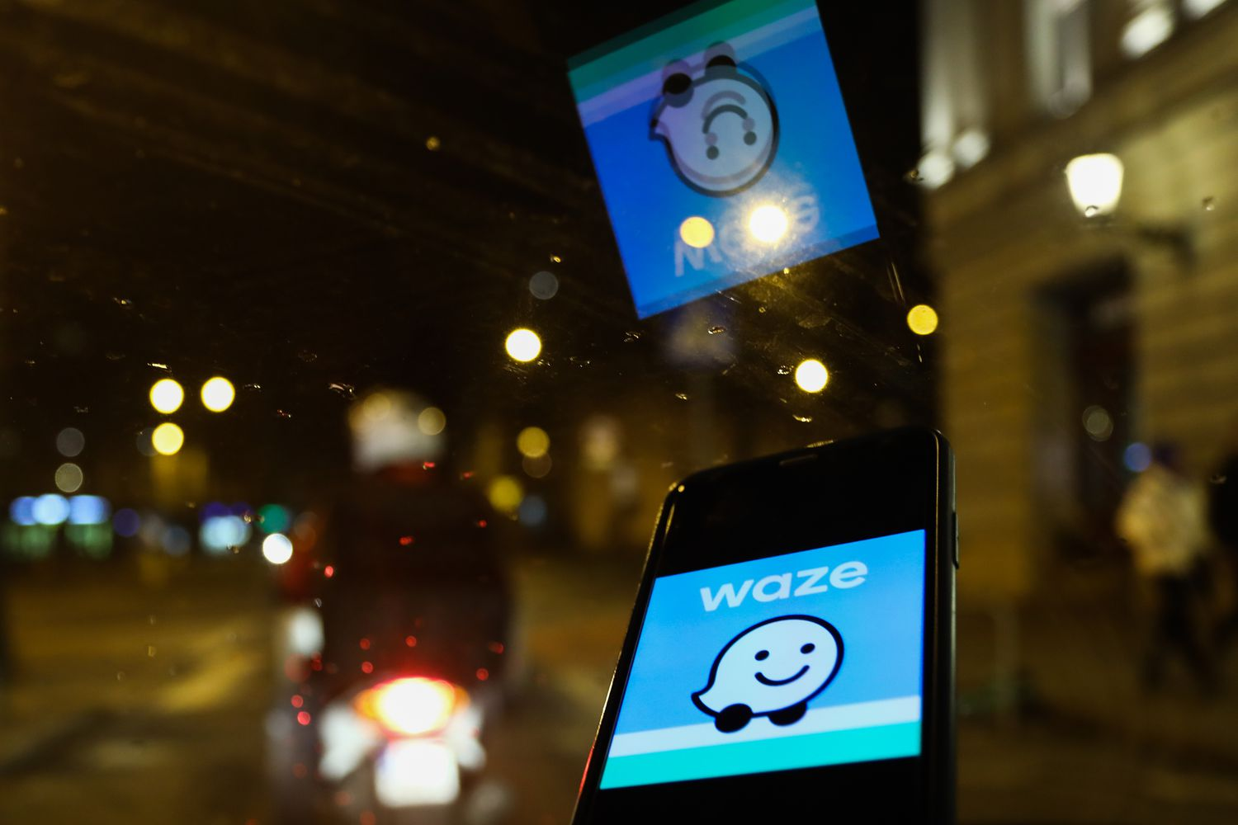
Future Research
Build a Predictive Model for Churn: Develop a model to identify users at risk of churning, enabling Waze to implement targeted interventions to improve user retention and satisfaction.
Logistics Regression
Random Forest
Gradient Boosting Machines

Slide 19
END

